Slide 1
Introduction to Cryptography and Security
IT4010E - 136318
Diffie-Hellman
Key Exchange Protocol
Cù Duy Hiệp – 20200212
Nguyễn Đức Thành – 20203913
Trần Đức Trí – 20204893

Slide 2
Content
THEORY
CRYPTANALYSIS
Diffie-Hellman
Key Exchange
Attack
ENHANCEMENT
Improvement of
Diffie-Hellman
Demonstration

Slide 3
THEORY OF DIFFIE-HELLMAN PROTOCOL
A mathematical method
The earliest work about the idea of private and public key
Exchange key over a public channel
Used to secure a variety of Internet services
One of the earliest practical examples of public key exchange
Provides the basis for many authenticated protocols

Slide 4
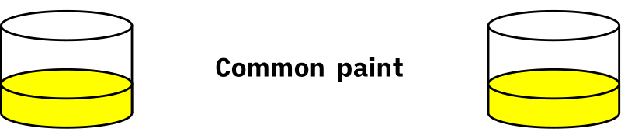
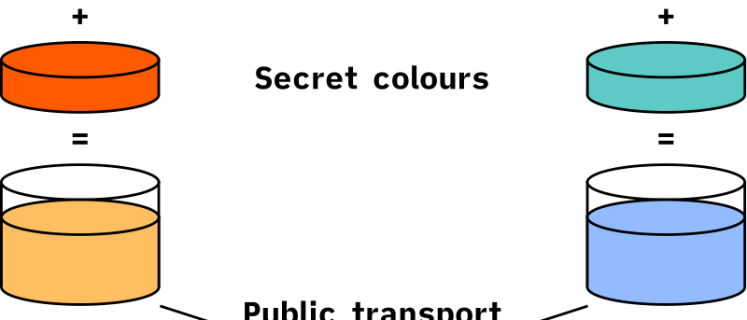
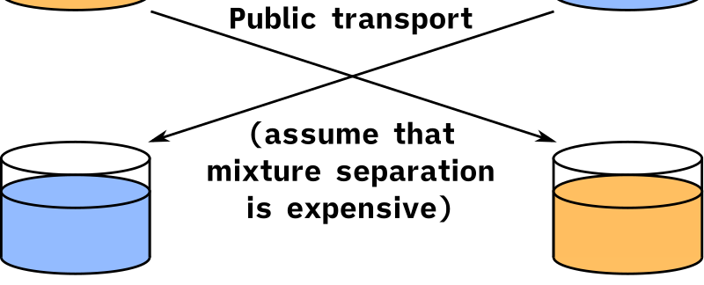
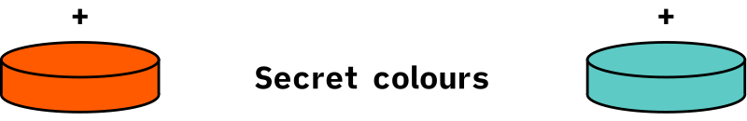
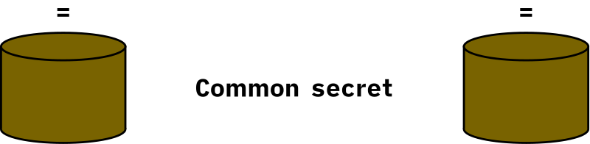
PROCESS OF DIFFIE-HELLMAN PROTOCOL
The process begins by having the two parties, Alice and Bob. They have agreed on an arbitrary starting color that could be public.
Then they choose their own secret key and mix it with the already set public key above.
The mixture will be transfer to the other side in a public channel.
After receive the message, they merge it with their own secret key.
The last mixture will be the key which is shared between Alice and Bob.

Slide 5
PROCESS OF DIFFIE-HELLMAN PROTOCOL
Here is a more general description of the protocol:
Alice and Bob agree on a prime number p and a generating element g in the finite cyclic group G. (This is usually done long before the rest of the protocol; g is assumed to be known by all attackers.) The group G is written multiplicatively.
Alice picks a random number a and sends the element gª mod p to Bob.
Bob picks a random number b and sends the element g^{b} mod p to Alice.
Alice computes the element (g^{b})ª mod p.
Bob computes the element (gª)^{b} mod p.
Both Alice and Bob are now in possession of the group element g^{ab} = g^{ba}, which can serve as the shared secret key.

Slide 6

Cryptanalysis
Eve
Alice
Intercept
Bob

Slide 7
Cryptanalysis
Brute force
Man-in-the-middle(MITM)
Choose g such that g is a primitive root of p
Choose large a, b(100-figure number) and p(300-figure number

Slide 8
Man-in-the-middle (MITM)
Eve
g^{d} (mod p)
g^{b} (mod p)
gª (mod p)
g^{c} (mod p)
gª (mod p)
g^{b} (mod p)
Alice
Intercept
Bob

Slide 9
Man-in-the-middle (MITM)
Eve
S₁
S₂
S₁ = g^{da} (mod p)
S₁
S₂
S₂ = g^{cb} (mod p)
Alice
Bob

Slide 10
How to prevent the attacker?

Slide 11

DIFFIE-HELLMAN INTEGRATED WITH RSA
The main idea of this method is that we use RSA algorithm to encrypt the public key that is sent from Alice to Bob and the other one from Bob to Alice:
1. Let Alice and Bob have agreed on a set of large prime number p, q, X and g.
2. They calculate n = p $×$ q, $Φ$(n) = (p – 1)(q – 1). Then they together choose a number e such that it co-prime with $Φ$(n) and $Φ$(n) > e > 1.
3. Alice choose a private number a; Bob choose a private number b.
4. Alice calculates the public key: S₁ = gª (mod X). Then she encrypts it with RSA: C₁ = S₁e (mod n), and send to Bob.
5. Bob calculates the public key: S₂ = g^{b} (mod X). Then he encrypts it with RSA: C₂ = S₂e (mod n), and send to Alice.
S₂ = g^{b} (mod X).
S₁ = gª (mod X)
C₁ = S₁e (mod n)
a
C₂ = S₂e (mod n)
b
Alice
P, q, X, g |
n = p $×$ q, $Φ$(n) = (p – 1)(q – 1) |
e
Bob

Slide 12


DIFFIE-HELLMAN INTEGRATED WITH RSA
Eve
C₁ = S₁e (mod n)
C₁ = S₁e (mod n)
Intercept
Alice
Bob

Slide 13
DIFFIE-HELLMAN INTEGRATED WITH RSA
 | Easy to implement
 | Less time to execute
 | Less prone to MITM attack

Slide 14
Demonstration

Slide 15
Thanks for listening!

